Slide 1
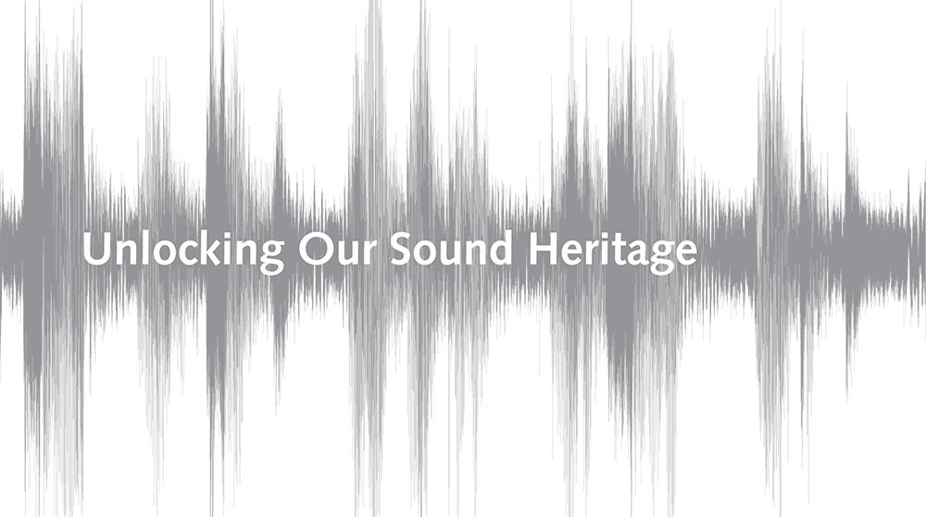



Tom Ruane | BISA 2018

Slide 2
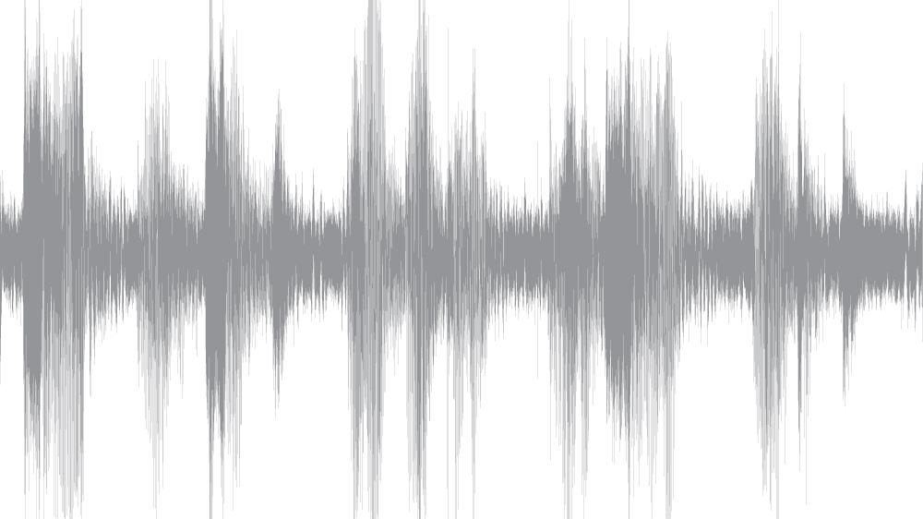
Outline
The challenges of setting up an audio preservation studio for Unlocking Our Sound Heritage
Our Aim
Preparation
Digitisation & delivery

Slide 3

Our Aim | regional partners
Archives+, Manchester
Bristol Culture
London Metropolitan Archives
The Keep, Brighton
National Museum Northern Ireland
National Library of Scotland
National Library of Wales
Norfolk Records Office
University of Leicester
Tyne & Wear Archives & Museums

Slide 4
Our Aim | preserving regional content
Project aim to digitise 160,000 items
British Library to digitise 110,000 items
Regional partners to digitise 50,000 items

Slide 5
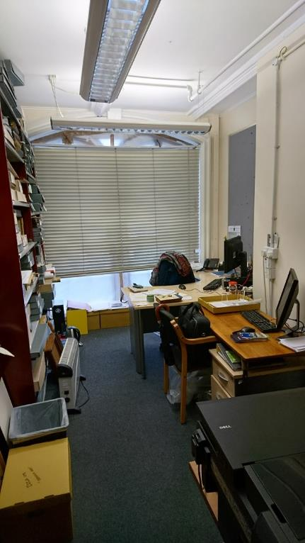
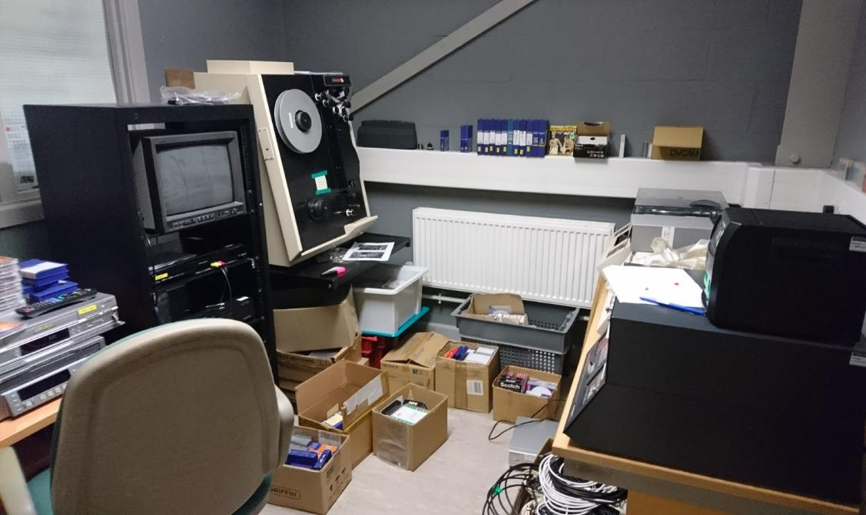
Preparation | selecting a studio space
National Library of Wales
Tyne & Wear

Slide 6
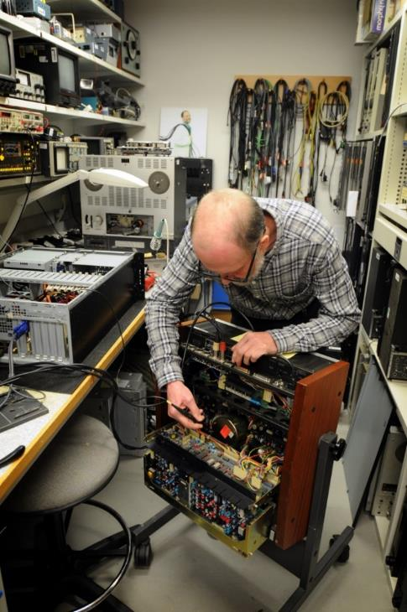
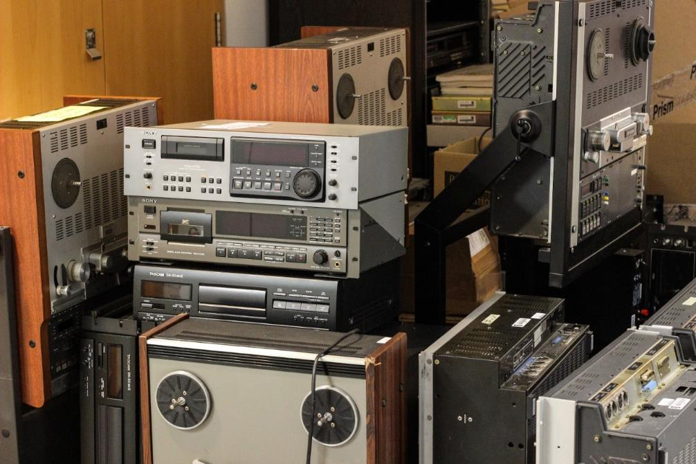
Preparation | sourcing equipment

Slide 7
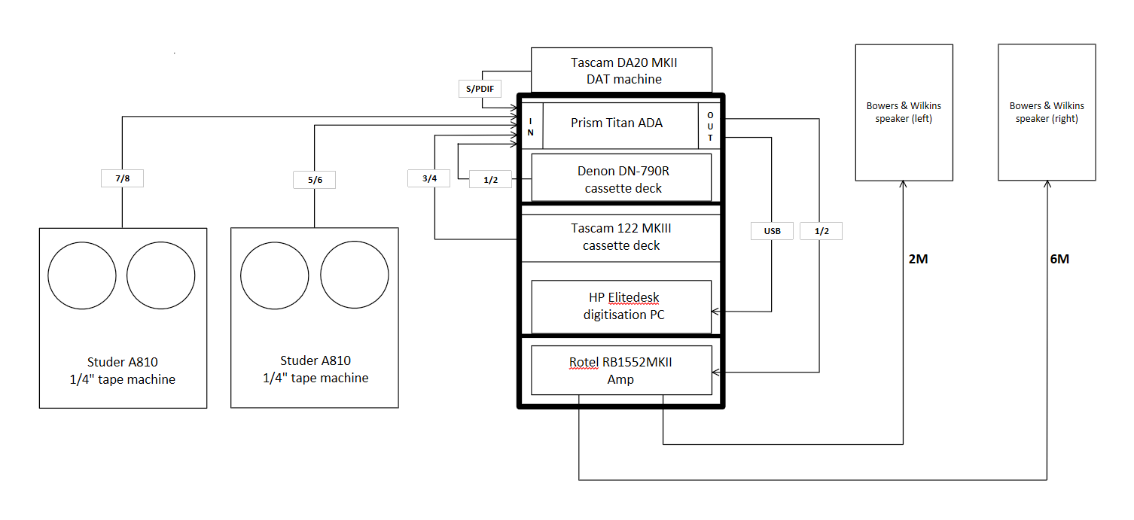
Preparation | sourcing equipment
Windows PC running Wavelab
Prism Titan ADA converter
Cassette deck (x2)
¼” tape machine (x2)
DAT machine
MiniDisc ripper
Rotel Amplifier
B&W speakers

Slide 8
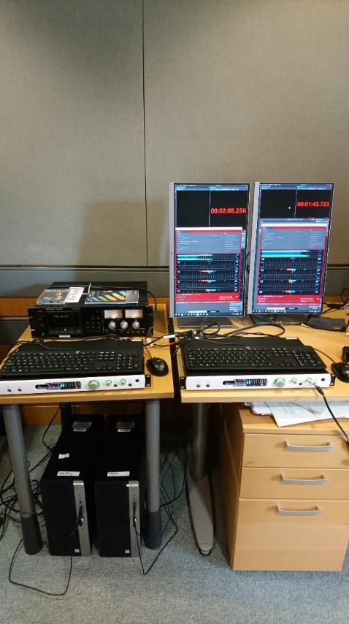
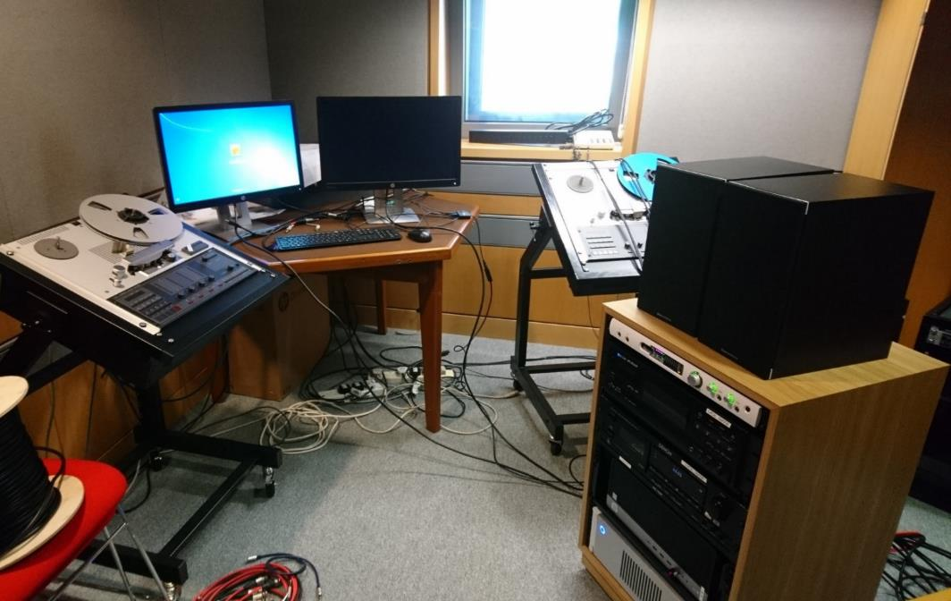
Preparation | equipment testing
Studio test build
Titan ADC testing

Slide 9
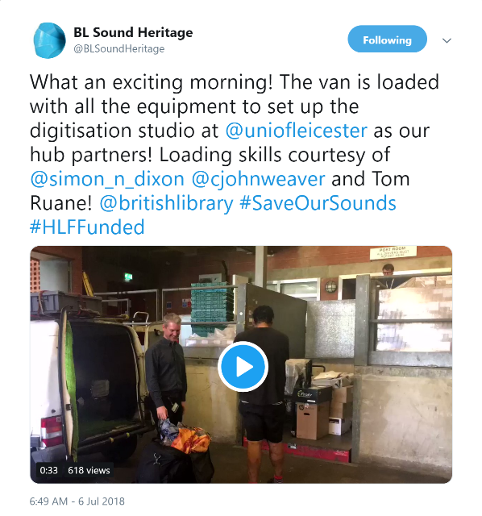
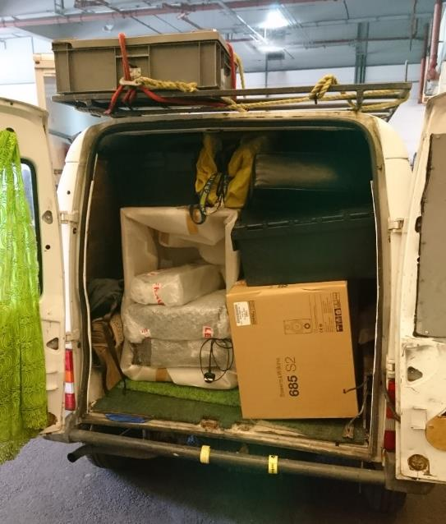
Preparation | shipping everything
Man & van!

Slide 10
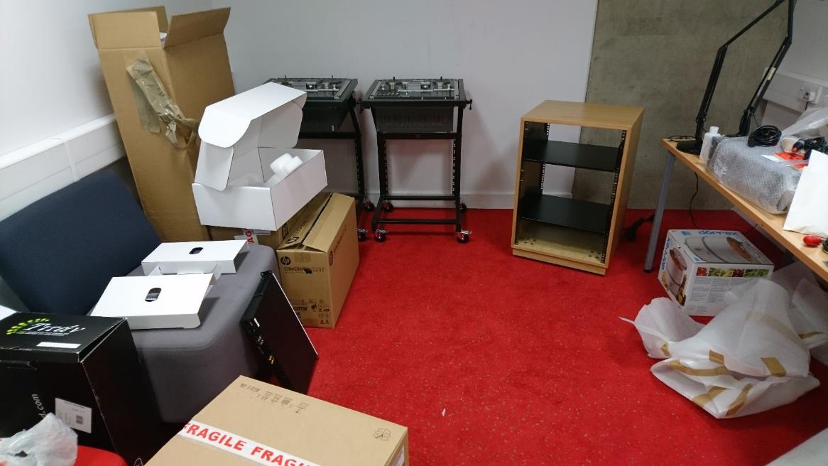
Digitisation & delivery | studio build
University of Leicester

Slide 11
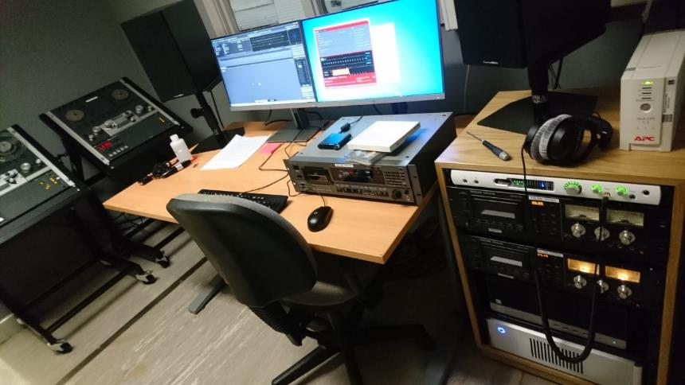
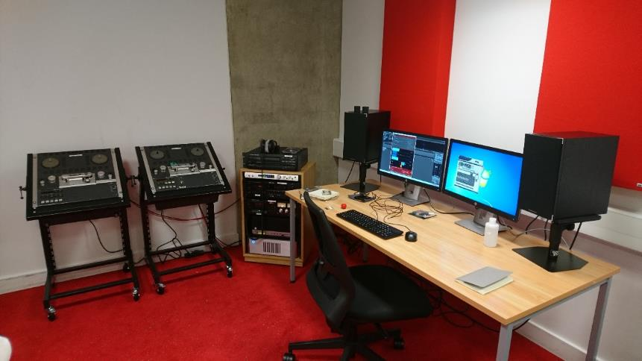
Digitisation & delivery | studio build
National Library of Wales
University of Leicester

Slide 12
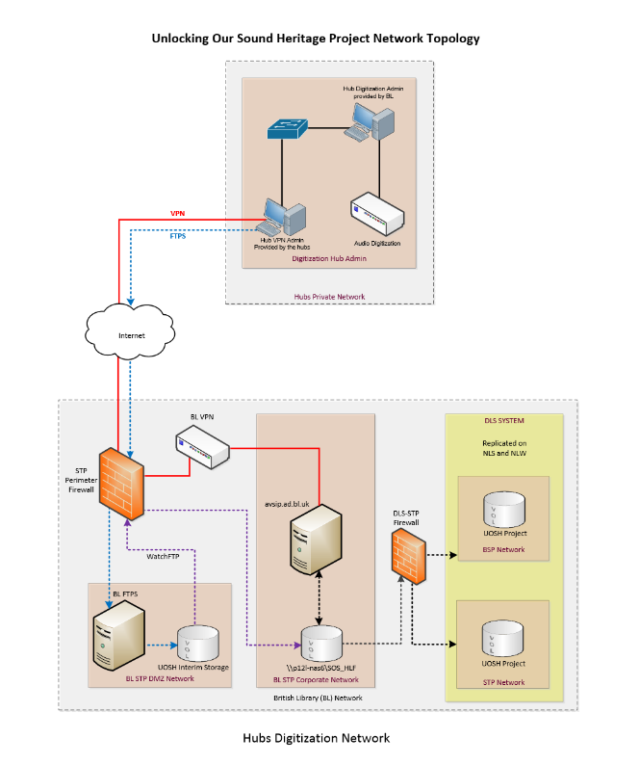
Digitisation & delivery | secure delivery
All digitised content to be archived at the British Library
Secure network required to deliver files
Upload schedule to reduce network strain
Hubs able to access BL network to complete workflow

Slide 13
Digitisation & delivery | next steps…
Project staff in post
Prioritise collections for digitisation
Cataloguing and digitisation workflow
Establish relationships with collection holders
Ongoing training & advice

